Slide 1
Advanced Programming
Computer Science Program
By: Biruk M.

Slide 2
Chapter six
Introduction to GUI-(AWT and Swing)

Slide 3
Introduction
A graphical user interface (GUI) presents a user-friendly mechanism for interacting with an application.
A GUI gives an application a distinctive “look” and “feel”.
There are two main sets of visual components and containers for user interface design in JAVA:
AWT (Abstract Window Toolkit) - in package java.awt and
Swing - in package javax.swing
When Java was introduced, the GUI classes were bundled in a library known as the Abstract Windows Toolkit (AWT).

Slide 4
AWT vs. Swing
AWT is fine for developing simple graphical user interfaces, but not for developing comprehensive GUI projects.
Besides, AWT is prone to platform-specific bugs.
The AWT user-interface components were replaced by a more robust, versatile, and flexible library known as Swing components.
Swing components depend less on the target platform and use less of the native GUI resource.
Swing components are painted directly on canvases using Java code.
For this reason, Swing components that don’t rely on native GUI are referred to as lightweight components, and AWT components are referred to as heavyweight components.

Slide 5
AWT vs. Swing (cont’d)
AWT features include:
A rich set of user interface components.
A robust event-handling model.
Graphics and imaging tools, including shape, color, and font classes.
Swing features include:
All the features of AWT.
100% Pure Java certified versions of the existing AWT component set (Button, Scrollbar, Label, etc.).
A rich set of higher-level components (such as tree view, list box, and tabbed panes).
Pure Java design, no reliance on peers.
Pluggable Look and Feel.

Slide 6
Java GUI API
The GUI API contains classes that can be classified into three groups:
component classes,
container classes, and
helper classes.
The component classes, such as JButton, JLabel, and JTextField, are for creating the user interface.
The container classes, such as JFrame, JPanel, and JApplet, are used to contain other components.
The helper classes, such as Graphics, Color, Font, FontMetrics, and Dimension, are used to support GUI components.

Slide 7
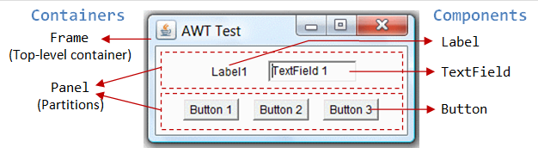
Java GUI API (cont’d)

Slide 8
Java GUI API (cont’d)
Class Object is the super class of the Java class hierarchy.
Component is the root class of all the user-interface classes including container classes.
JComponent is the root class of all the lightweight Swing components.
An instance of Container can hold instances of Component.
Window, Panel, Applet, Frame, and Dialog are the container classes for AWT components.
To work with Swing components, use Container, JFrame, JDialog, JApplet, and Jpanel.

Slide 9
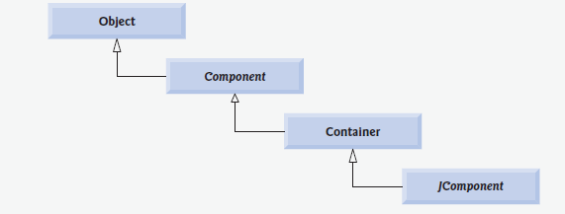
Java GUI API (cnt’d)
Common super classes of many of the Swing components

Slide 10
Frames
To create a user interface, you need to create either a frame or an applet to hold the user-interface components.
A top-level window (that is, a window that is not contained inside another window) is called a frame in Java.
A Frame has:
a title bar (containing an icon, a title, and the minimize/maximize(restore-down)/close buttons),
an optional menu bar and
the content display area.
To create a frame, use the JFrame class

Slide 11
Frame
Example 1
import javax.swing.JFrame;
public class MyFrame {
public static void main(String[] args) {
// Create a frame
JFrame frame = new JFrame("MyFrame");
frame.setSize(400, 300); // Set the frame size
// Center a frame
frame.setLocationRelativeTo(null); //or .setLocation(300,200)
frame.setDefaultCloseOperation(JFrame.EXIT_ON_CLOSE);
frame.setVisible(true); // Display the frame
}
}

Slide 12
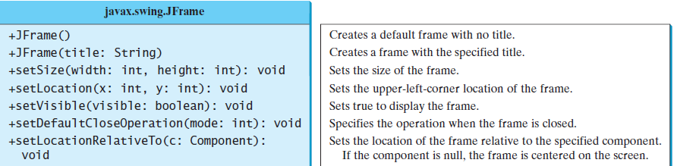
Frame (cont’d)
JFrame is a top-level container to hold GUI components

Slide 13
Frame (cont’d)
Adding Components to a Frame
import javax.swing.JFrame;
import javax.swing.JButton;
public class FrameWithButton {
public static void main(String[] args) {
JFrame frame = new JFrame("MyFrame");
// Add a button into the frame
JButton jbtOK = new JButton("OK");
frame.add(jbtOK);
frame.setSize(400, 300);
frame.setLocation(360,360);
frame.setDefaultCloseOperation(JFrame.EXIT_ON_CLOSE);
frame.setVisible(true);
}
}

Slide 14
Frame (cont’d)
Adding Lablel
import javax.swing.JFrame;
import javax.swing.JLabel;
public class FrameWithLabel {
public static void main(String[] args) {
JFrame frame = new JFrame("MyFrame");
// Add a lable into the frame
JLabel jLblName = new JLabel(“First Name");
frame.add(jLblName);
frame.setSize(400, 300);
frame.setLocation(360,360);
frame.setDefaultCloseOperation(JFrame.EXIT_ON_CLOSE);
frame.setVisible(true);
}
}

Slide 15
Layout Managers
Java’s layout managers provide a level of abstraction that automatically maps your user interface on all window systems.
The Java GUI components are placed in containers, where they are arranged by the container’s layout manager.
Layout managers are set in containers using the setLayout(aLayoutManager) method.
This section introduces three basic layout managers: FlowLayout, GridLayout, and BorderLayout.

Slide 16
FlowLayout
Flowlayout
Is the simplest layout manager.
The components are arranged in the container from left to right in the order in which they were added. When one row is filled, a new row is started.
You can specify the way the components are aligned by using one of three constants:
FlowLayout RIGHT,
FlowLayout.CENTER, or
FlowLayout.LEFT.
You can also specify the gap between components in pixels.

Slide 17
FlowLayout (cont’d)
EXAMPLE
import javax.swing.JLabel;
import javax.swing.JTextField;
import javax.swing.JFrame;
import java.awt.FlowLayout;
public class ShowFlowLayout extends JFrame{
public ShowFlowLayout() {
// Set FlowLayout, aligned left with horizontal gap 10
// and vertical gap 20 between components
setLayout(new FlowLayout(FlowLayout.LEFT, 10, 20) );
// Add labels and text fields to the frame
add(new JLabel("First Name"));
add(new JTextField(8));
add(new JLabel("MI"));
add(new JTextField(1));
add(new JLabel("Last Name"));
add(new JTextField(8));
}

Slide 18
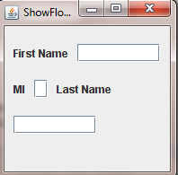
FlowLayout (cont’d)
/** Main method */
public static void main(String[] args) {
ShowFlowLayout frame = new ShowFlowLayout();
frame.setTitle("ShowFlowLayout");
frame.setSize(200, 200);
frame.setLocationRelativeTo(null); // Center the frame
frame.setDefaultCloseOperation(JFrame.EXIT_ON_CLOSE);
frame.setVisible(true);
}
}
Output

Slide 19
GridLayout
Arranges components in a grid (matrix) formation.
The components are placed in the grid from left to right, starting with the first row, then the second, and so on, in the order in which they are added.

Slide 20
GridLayout (cont’d)
EXAMPLE
import javax.swing.JLabel;
import javax.swing.JTextField;
import javax.swing.JFrame;
import java.awt.GridLayout;
public class ShowGridLayout extends JFrame {
public ShowGridLayout() {
// Set GridLayout, 3 rows, 2 columns, and gaps 5 between
// components horizontally and vertically
setLayout(new GridLayout(3, 2, 5, 5));
// Add labels and text fields to the frame
add(new JLabel("First Name"));
add(new JTextField(8));
add(new JLabel("MI"));
add(new JTextField(1));
add(new JLabel("Last Name"));
add(new JTextField(8));
}

Slide 21
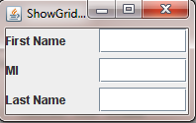
GridLayout (cont’d)
/** Main method */
public static void main(String[] args) {
ShowGridLayout frame = new ShowGridLayout();
frame.setTitle("ShowGridLayout");
frame.setSize(200, 125);
frame.setLocationRelativeTo(null); // Center the frame
frame.setDefaultCloseOperation(JFrame.EXIT_ON_CLOSE);
frame.setVisible(true);
}
}
Output

Slide 22
BorderLayout
Divides a container into five areas: East, South, West, North, and Center.
Components are added to a BorderLayout by using add(Component, index), where index is a constant
BorderLayout.EAST,
BorderLayout.SOUTH,
BorderLayout.WEST,
BorderLayout.NORTH, or
BorderLayout.CENTER.

Slide 23
BorderLayout
EXAMPLE
import javax.swing.JButton;
import javax.swing.JFrame;
import java.awt.BorderLayout;
public class ShowBorderLayout extends JFrame
{
public ShowBorderLayout() {
// Set BorderLayout with horizontal gap 5 and vertical gap 10
setLayout( new BorderLayout(5, 10));
// Add buttons to the frame
add(new JButton("East"), BorderLayout.EAST);
add(new JButton("South"), BorderLayout.SOUTH);
add(new JButton("West"), BorderLayout.WEST);
add(new JButton("North"), BorderLayout.NORTH);
add(new JButton("Center"), BorderLayout.CENTER);
}

Slide 24
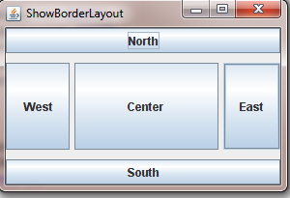
BorderLayout (cont’d)
/** Main method */
public static void main(String[] args) {
ShowBorderLayout frame = new ShowBorderLayout();
frame.setTitle("ShowBorderLayout");
frame.setSize(300, 200);
frame.setLocationRelativeTo(null); // Center the frame
frame.setDefaultCloseOperation(JFrame.EXIT_ON_CLOSE);
frame.setVisible(true);
}
}
Output

Slide 25
Panels
With Java GUI programming, you can divide a window into panels.
Panels act as subcontainers to group user-interface components.
You add the buttons in one panel, then add the panel into the frame.
You can use new JPanel() to create a panel with a default FlowLayout manager or new Panel(LayoutManager) to create a panel with the specified layout manager.

Slide 26
Panels (cont’d)
Example 1
import java.awt.GridLayout;
import javax.swing.*;
import java.awt.BorderLayout;
public class SimplePanel1 extends JFrame {
public SimplePanel1() {
// Create panel p1 for the buttons and set GridLayout
JPanel p1 = new JPanel();
p1.setLayout(new GridLayout(1, 2));
//Add label and text field to the panel
p1.add(new JLabel("First Name"));
p1.add(new JTextField(8));
// Create panel p2 to hold a p1
JPanel p2 = new JPanel(new BorderLayout());
p2.add(p1, BorderLayout.NORTH);
p2.add (new JButton("Button in Panel 2"));
// add contents into the frame
add(p2);
}

Slide 27
Panels (cont’d)
/** Main method */
public static void main(String[] args) {
SimplePanel1 frame = new SimplePanel1();
frame.setTitle("Panel With Components");
frame.setSize(300, 100);
frame.setLocationRelativeTo(null); // Center the frame
frame.setDefaultCloseOperation(JFrame.EXIT_ON_CLOSE);
frame.setVisible(true);
}
}

Slide 28
Panels (cont’d)
Example 2
import java.awt.GridLayout;
import javax.swing.*;
import java.awt.BorderLayout;
public class TestPanels extends JFrame {
public TestPanels() {
// Create panel p1 for the buttons and set GridLayout
JPanel p1 = new JPanel();
p1.setLayout(new GridLayout(4, 3));
//Add buttons to the panel
for (int i = 1; i <= 9; i++) {
p1.add(new JButton("" + i));
}

Slide 29
Panels (cont’d)
p1.add(new JButton("" + 0));
p1.add(new JButton("Start"));
p1.add(new JButton("Stop"));
// Create panel p2 to hold a text field and p1
JPanel p2 = new JPanel(new BorderLayout());
p2.add (new JTextField("Time to be displayed here"),
BorderLayout.NORTH);
p2.add(p1, BorderLayout.CENTER);
// add contents into the frame
add(p2, BorderLayout.EAST);
add(new JButton("Food to be placed here"),
BorderLayout.CENTER);
}

Slide 30
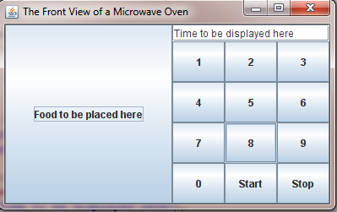
Panels (cont’d)
/** Main method */
public static void main(String[] args) {
TestPanels frame = new TestPanels();
frame.setTitle("The Front View of a Microwave Oven");
frame.setSize(400, 250);
frame.setLocationRelativeTo(null); // Center the frame
frame.setDefaultCloseOperation(JFrame.EXIT_ON_CLOSE);
frame.setVisible(true);
}
}
Output

Slide 31
The Font Class
You can create a font using the java.awt.Font class and set fonts for the components using the setFont method in the Component class.
The constructor for Font is:
Font(String name, int style, int size);
You can choose a font name from SansSerif, Serif, Monospaced, Dialog, or DialogInput,
Choose a style from Font.PLAIN (0), Font.BOLD (1), Font.ITALIC (2), and Font.BOLD Font.ITALIC (3), and specify a font size of any positive integer.

Slide 32
Font (cont’d)
Example:
Font font1 = new Font("SansSerif", Font.BOLD, 16);
Font font2 = new Font("Serif", Font.BOLD + Font.ITALIC, 12);
JButton jbtOK = new JButton("OK");
jbtOK.setFont(font1);

Slide 33
The Color Class
You can set colors for GUI components by using the java.awt.Color class.
Colors are made of red, green, and blue components, each represented by an int value that describes its intensity, ranging from 0 (darkest shade) to 255 (lightest shade).
You can create a color using the following constructor:
public Color(int r, int g, int b);
Example:
Color color = new Color(128, 100, 100);
You can use the setBackground(Color c) and setForeground(Color c) methods to set a component’s background and foreground colors.

Slide 34
The Color Class (cont’d)
Example
JButton jbtOK = new JButton("OK");
jbtOK.setBackground(color);
jbtOK.setForeground(new Color(100, 1, 1));
Alternatively, you can use one of the 13 standard colors (BLACK, BLUE, CYAN, DARK_GRAY, GRAY, GREEN, LIGHT_GRAY, MAGENTA, ORANGE, PINK, RED, WHITE, and YELLOW) defined as constants in java.awt.Color.
The following code, for instance, sets the foreground color of a button to red:
jbtOK.setForeground(Color.RED);

Slide 35
The Color Class (cont’d)
Example
import java.awt.GridLayout;
import java.awt.Color;
import javax.swing.*;
public class ColorExample extends JFrame{
public ColorExample(){
JFrame jf = new JFrame("Color Frame");
setLayout(new GridLayout(1,2));
Color color = new Color(128, 100, 100);
JButton bc1 = new JButton("Left Button");
JButton bc2 = new JButton("Right Button");
bc1.setBackground(color);
bc2.setForeground(new Color(250,0, 0)); //bc2.setForeground(Color.BLUE);
add(bc1);
add(bc2);
}

Slide 36
The Color Class (cont’d)
public static void main(String[] args){
ColorExample ce = new ColorExample();
ce.setSize(300,150);
ce.setDefaultCloseOperation(JFrame.EXIT_ON_CLOSE);
ce.setLocationRelativeTo(null);
ce.setVisible(true);
}
}

Slide 37
Event Handling
Event and Event Source
When you run a Java GUI program, the program interacts with the user, and the events drive its execution.
An event can be defined as a signal to the program that something has happened.
Events are triggered either by external user actions, such as mouse movements, button clicks, and keystrokes, or by internal program activities, such as a timer.
The program can choose to respond to or ignore an event.
The component that creates an event and fires it is called the source object or source component.
For example, a button is the source object for a button-clicking action event.
An event is an instance of an event class.

Slide 38
Event Handling
Java has a number of events and event handlers.
Java.awt.event –is the main package
It is up to the programmer to decide what to be executed, how to handle the generated event, etc
There are more than 16 event types in java.
Eventhandler and ActionListener are the two important aspects in event manipulation
Adding Listener helps to organize the action(event) to be done after the button or the GUI control is selected
ActionListner is the main Interface in event handling

Slide 39
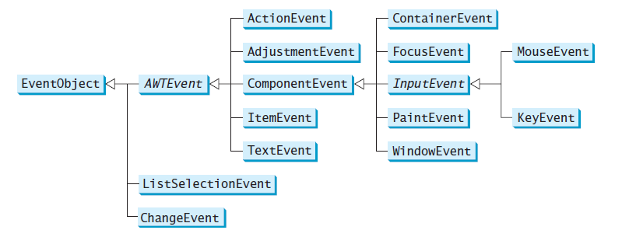
Event Handling (cont’d)
An event is an object of the EventObject class.

Slide 40
Event Handling (cont’d)
Listeners, Registrations, and Handling Events
Java uses a delegation-based model for event handling:
a source object fires an event, and an object interested in the event handles it. The latter object is called a listener.
For an object to be a listener for an event on a source object, two things are needed:
The listener object must be an instance of the corresponding event-listener interface to ensure that the listener has the correct method for processing the event. The following table lists event types, the corresponding listener interfaces, and the methods defined in the listener interfaces.
The listener object must be registered by the source object. Registration methods depend on the event type. For ActionEvent, the method is addActionListener.

Slide 41
Event Handling (cont’d)
Example 1
import javax.swing.*;
import java.awt.event.*;
public class HandleEvent extends JFrame{
public HandleEvent() {
// Create two buttons
JButton jbtOK = new JButton("OK");
JButton jbtCancel = new JButton("Cancel");
// Create a panel to hold buttons
JPanel panel = new JPanel();
panel.add(jbtOK);
panel.add(jbtCancel);
add(panel); // Add panel to the frame

Slide 42
Event Handling (cont’d)
// Register listeners
OKListenerClass listener1 = new OKListenerClass();
CancelListenerClass listener2 = new CancelListenerClass();
jbtOK.addActionListener(listener1);
jbtCancel.addActionListener(listener2);
}
public static void main(String[] args) {
JFrame frame = new HandleEvent();
frame.setTitle("Handle Event");
frame.setSize(200, 150);
frame.setLocation(200, 100);
frame.setDefaultCloseOperation(JFrame.EXIT_ON_CLOSE);
frame.setVisible(true);
}
}

Slide 43
Event Handling (cont’d)
class OKListenerClass implements ActionListener{
public void actionPerformed(ActionEvent e) {
System.out.println("OK button clicked");
}
}
class CancelListenerClass implements ActionListener{
public void actionPerformed(ActionEvent e) {
System.out.println("Cancel button clicked");
}
}

Slide 44
Event Handling (cont’d)
Example 2
import javax.swing.*;
import java.awt.event.*;
import java.awt.*;
public class MyGUI extends Jframe
implements ActionListener {
private JButton clickme = new JButton("ClickMe");
private JButton tests = new JButton("Test");
public MyGUI() {
// Add clickme to the GUI and assign it a listener
setLayout(new GridLayout(2, 0, 5, 5));
add(clickme);
add(tests);
clickme.addActionListener(this);
setDefaultCloseOperation(JFrame.EXIT_ON_CLOSE);
setSize(200,200);
setVisible(true);
}

Slide 45
public void actionPerformed(ActionEvent e) {
if (e.getSource() == clickme) {
tests.setText("Clickme button clicked");
}
} // actionPerformed()
public static void main(String args[]) {
MyGUI gui = new MyGUI();
}
} // MyGUI class

Slide 46
exercise
Design GUI?
Design and Event?
Bonus Qtns?

